Slide 1

Convolutional Neural Network (CNN)

Slide 2
Limitations of Dense Layer
Convolutional Layer
Convolutional Neural Network (CNN)
Image Processing & Augmentation

Slide 3
CNN Architectures
Transfer Learning

Slide 4
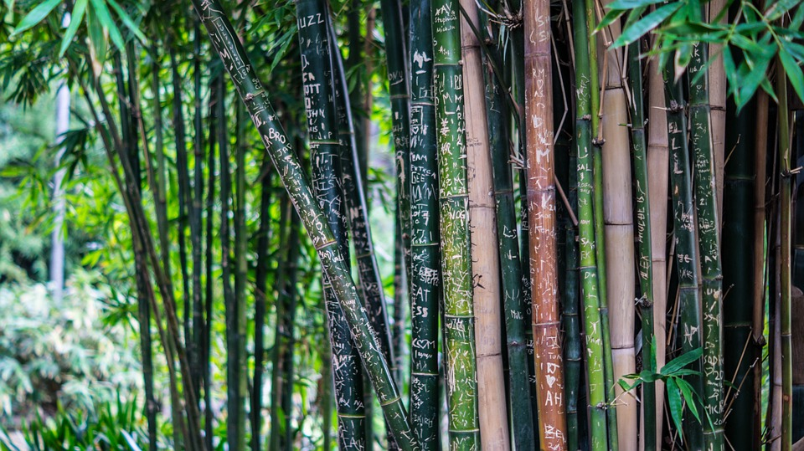
Revisiting Dense Layers

Slide 5
Input
Output
Also called Fully connected Layers

Slide 6

Number of Weights
784 Weights + bias
28x28x1
784 Weights + bias
784 Weights + bias
784 Weights + bias
Initial Layer
200 Neurons * (784+1) = 157,000

Slide 7

Number of Weights
How many weights for each Neuron?
28x28x3
2,352 + 1
200 Neurons * (2352+1) = 470,600
Initial Layer

Slide 8
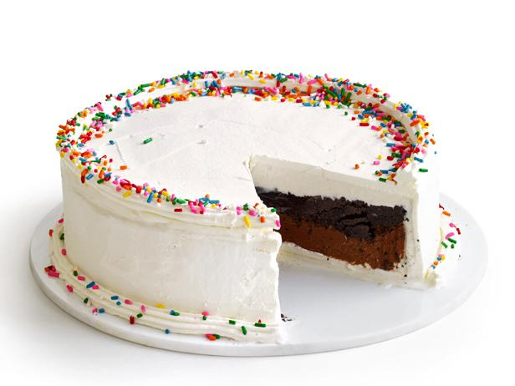
Number of Weights
300x300x3
300 * 300 * 3 + 1
200 Neurons * (270,000+1) = 54,000,200
Network becomes unmanageable :(

Slide 9
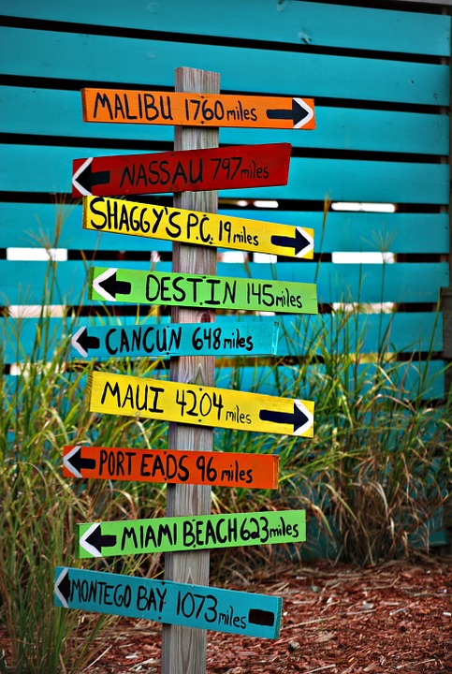
Spatial (Location)
Information

Slide 10
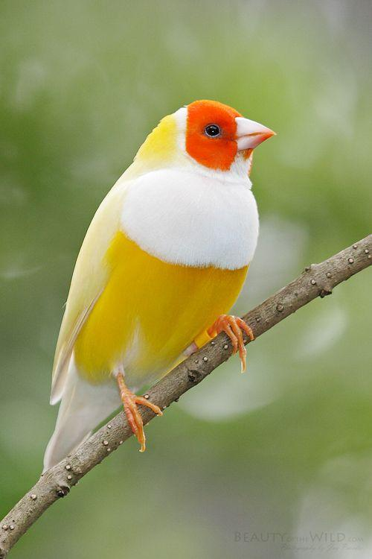
Where is the eye in the picture?

Slide 11
Do we have two eyes in the picture?
No, we recognize eye being near to forehead, nose etc.

Slide 12

How does a neuron look at the image (input) in Dense layer?

Slide 13




Extract data row by row

Slide 14
Arrange all data in one row i.e a vector
This makes data being fed to neuron having very little neighbourhood information … makes it harder for machine to learn

Slide 15
32 | 27 | 33 | 12 | 18 | 29 | 37 | 27
29 | 18 | 28 | 16 | 27 | 18 | 29 | 30
2 | 33 | 66 | 155 | 160 | 23 | 32 | 28
32 | 27 | 99 | 180 | 192 | 86 | 199 | 100
47 | 90 | 180 | 190 | 170 | 30 | 21 | 39
13 | 100 | 143 | 195 | 37 | 29 | 22 | 26
33 | 142 | 16 | 28 | 28 | 26 | 28 | 30
149 | 27 | 26 | 17 | 29 | 30 | 29 | 27
Humans
How Machine sees picture

Slide 16
32 | 27 | 33 | 12 | 18 | 29 | 37 | 27
29 | 18 | 28 | 16 | 27 | 18 | 29 | 30
2 | 33 | 66 | 155 | 160 | 23 | 32 | 28
32 | 27 | 99 | 180 | 192 | 86 | 199 | 100
47 | 90 | 180 | 190 | 170 | 30 | 21 | 39
13 | 100 | 143 | 195 | 37 | 29 | 22 | 26
33 | 142 | 16 | 28 | 28 | 26 | 28 | 30
149 | 27 | 26 | 17 | 29 | 30 | 29 | 27
Neighbours of ‘180’ ?

Slide 17
32 | 27 | 33 | 12 | 18 | 29 | 37 | 27
29 | 18 | 28 | 16 | 27 | 18 | 29 | 30
2 | 33 | 66 | 155 | 160 | 23 | 32 | 28
32 | 27 | 99 | 180 | 192 | 86 | 199 | 100
47 | 90 | 180 | 190 | 170 | 30 | 21 | 39
13 | 100 | 143 | 195 | 37 | 29 | 22 | 26
33 | 142 | 16 | 28 | 28 | 26 | 28 | 30
149 | 27 | 26 | 17 | 29 | 30 | 29 | 27
We can easily locate neighbours of 180.

Slide 18
FC Layer
Flatten
2352x1
Neuron
28x28x3
FC Layer can work only with Vectors as input

Slide 19
... | ... | ... | ... | 27 | 99 | 180 | ... | ... | ... | ... | 90 | 180 | 190 | ... | ... | ... | ... | 100 | 143 | 195 | ... | ... | ...
When reshaping the input for FC layer, Spatial information is lost

Slide 20

Convolutional Layer

Slide 21
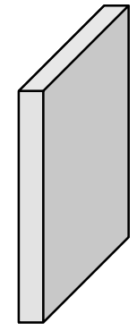
Input Shape
Image
In convolutional layer, we do not flatten input
e.g. a 3 dimensional input will remain 3 dimensional and not become a vector
neighbourhood information is not lost.
28x28x3

Slide 22
Neuron’s Input
Image
In Dense layer, a neuron looks at entire input at once
Neuron
This makes neuron has same number of weights as input features
28x28x3

Slide 23
Neuron Input Size
Image
In convolutional layer, a neuron does not get whole image to look at unlike FC Layer
Neuron
28x28x3

Slide 24
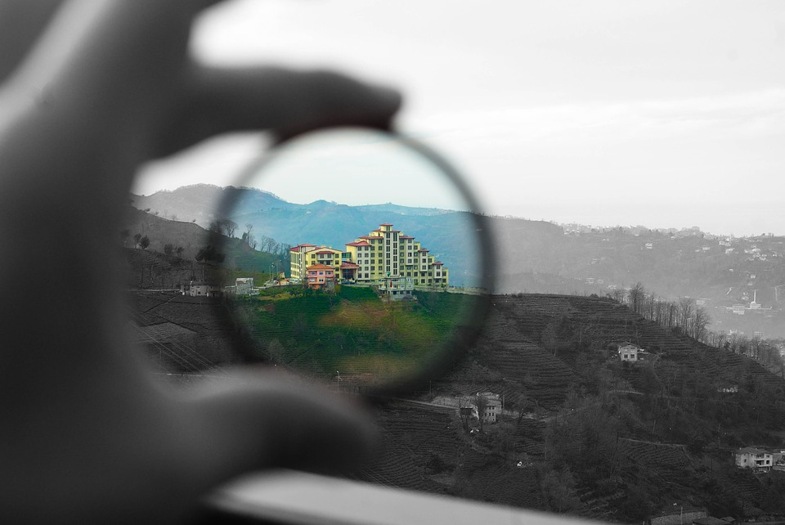
Using Filter

Slide 25

Image
filter
Neuron (or filter) gets to look at only part of the image at once
5x5x3
28x28x3

Slide 26
Image
Neuron (or filter) gets to look at only part of the image at once
filter
Filter size (width and depth) is usually much smaller than input width/height
5x5x3
28x28x3

Slide 27

Apply filter in top-left part
Part of the image
Filter
Output

Slide 28
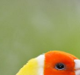
Apply filter in 2nd part
Part of the image
Filter
2nd Output

Slide 29
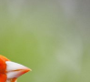
Apply filter in 3rd part
Part of the image
Filter
3rd Output

Slide 30

Apply filter in 4th part
Part of the image
Filter
4th Output
Filter will slide over entire input … creating multiple outputs

Slide 31
Applying filter
(Using numbers)
Image
32 | 27 | 33 | 12 | 18 | 29 | 37 | 27
29 | 18 | 28 | 16 | 27 | 18 | 29 | 30
2 | 33 | 66 | 155 | 160 | 23 | 32 | 28
32 | 27 | 99 | 180 | 192 | 86 | 199 | 100
47 | 90 | 180 | 190 | 170 | 30 | 21 | 39
13 | 100 | 143 | 195 | 37 | 29 | 22 | 26
33 | 142 | 16 | 28 | 28 | 26 | 28 | 30
149 | 27 | 26 | 17 | 29 | 30 | 29 | 27
filter
1 | 0 | 12
2 | 15 | 1
1 | 10 | 0
3x3x1
8x8x1

Slide 32
Neuron Output
Image
32 | 27 | 33 | 12 | 18 | 29 | 37 | 27
29 | 18 | 28 | 16 | 27 | 18 | 29 | 30
2 | 33 | 66 | 155 | 160 | 23 | 32 | 28
32 | 27 | 99 | 180 | 192 | 86 | 199 | 100
47 | 90 | 180 | 190 | 170 | 30 | 21 | 39
13 | 100 | 143 | 195 | 37 | 29 | 22 | 26
33 | 142 | 16 | 28 | 28 | 26 | 28 | 30
149 | 27 | 26 | 17 | 29 | 30 | 29 | 27
filter
1 | 0 | 12
2 | 15 | 1
1 | 10 | 0
3x3x1
Output is a dot product
8x8x1
= (32*1) + (27*0) + (33*12) + (29*2) +(18*15) + (28*1) + (2*1) + (33*10) + (66*0)
= 1116

Slide 33
Next Output
Image
32 | 27 | 33 | 12 | 18 | 29 | 37 | 27
29 | 18 | 28 | 16 | 27 | 18 | 29 | 30
2 | 33 | 66 | 155 | 160 | 23 | 32 | 28
32 | 27 | 99 | 180 | 192 | 86 | 199 | 100
47 | 90 | 180 | 190 | 170 | 30 | 21 | 39
13 | 100 | 143 | 195 | 37 | 29 | 22 | 26
33 | 142 | 16 | 28 | 28 | 26 | 28 | 30
149 | 27 | 26 | 17 | 29 | 30 | 29 | 27
filter
Filter weight remain same for different parts of the images
1 | 0 | 12
2 | 15 | 1
1 | 10 | 0
3x3x1
dot product
8x8x1
= (27*1) + (33*0) + (12*12) + (18*2) +(28*15) + (16*1) + (33*1) + (66*10) + (155*0)
= 1336

Slide 34
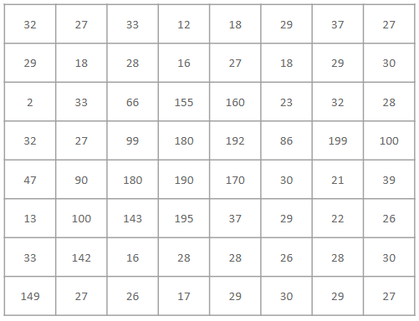

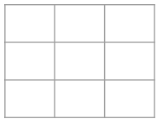
3D Image
Output
Filter
Convolution Layer
3x3x1
Number of weights - 9
Size decided by us
Original Image
6x6x1
8x8x1
8x8x1
Flattened Image (1D)
64 (1D)
Dense Layer
Neuron
64 (1D)
Number of weights 64
Size equal to number of input features
Output
1

Slide 35
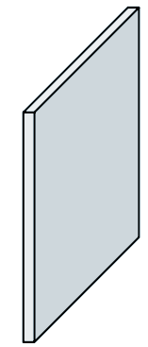
Outputs
Image
filter
5x5x3
How many Weights to learn?
28x28x3
75

Slide 36
Input Image
Outputs
(Activation Map)
‘Slide’ Filter over entire image
5x5x3
Size?
28x28x3
24x24

Slide 37
vs
Fully Connected
Convolution
Requires one dimensional input, no neighbourhood info
Can work with multi-dimensional data, uses neighbourhood info
Large number of weights
Smaller number of weights
One output per neuron
Multiple outputs per neuron
Less calculations
More calculations

Slide 38
What is the goal of Convolutional Layer?
Build a good filter which identifies a feature in the input

Slide 39
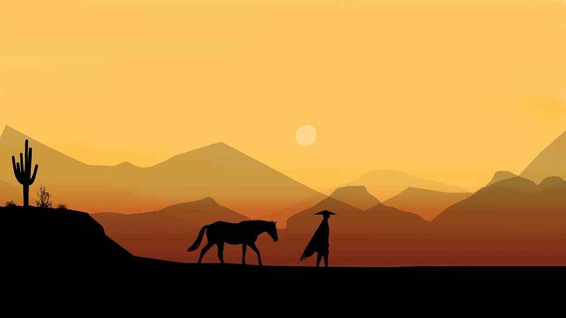
Visualizing
a filter

Slide 40
0 | 0 | 0 | 50 | 0
0 | 0 | 50 | 0 | 0
0 | 0 | 50 | 0 | 0
0 | 0 | 50 | 0 | 0
0 | 0 | 0 | 0 | 0
5x5 filter
Filter visual

Slide 41
Input Image
Let’s apply filter on this image

Slide 42
Image part where filter is being applied
0 | 0 | 0 | 30 | 30
0 | 0 | 30 | 0 | 0
0 | 0 | 30 | 0 | 0
0 | 0 | 30 | 0 | 0
0 | 0 | 0 | 0 | 0
0 | 0 | 0 | 50 | 0
0 | 0 | 50 | 0 | 0
0 | 0 | 50 | 0 | 0
0 | 0 | 50 | 0 | 0
0 | 0 | 0 | 0 | 0
X
Image Part as numbers
filter
= (30*50) + (30*50) + (30*50) + (30*50)
6000

Slide 43
Image part where filter is being applied
30 | 0 | 0 | 0 | 0
0 | 30 | 0 | 0 | 0
0 | 0 | 30 | 0 | 0
0 | 0 | 0 | 30 | 0
0 | 0 | 0 | 0 | 30
0 | 0 | 0 | 50 | 0
0 | 0 | 50 | 0 | 0
0 | 0 | 50 | 0 | 0
0 | 0 | 50 | 0 | 0
0 | 0 | 0 | 0 | 0
X
Part of Image
filter
= (30*50)
1500

Slide 44
What does large output signify?
Presence of the ‘feature’ represented by the filter

Slide 45
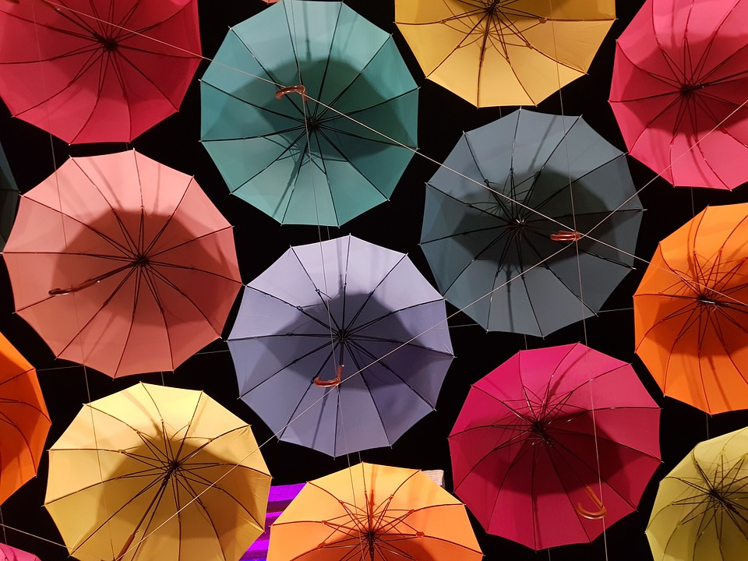
Building
Multiple filters

Slide 46



Input Image
Output
Filters
5x5x3
5x5x3
Size?
28x28x3
2 Filters -> 2 Activation Maps
24x24x2

Slide 47
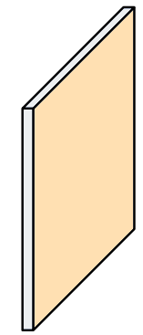

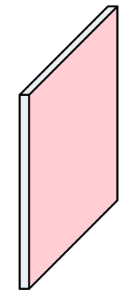
Input Image
Output
5 Filters
5x5x3
Size
28x28x3
24x24x5

Slide 48
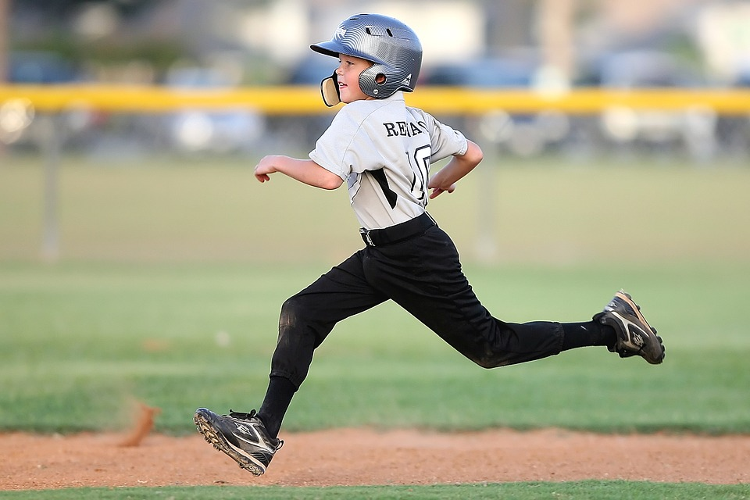
Filter Stride

Slide 49
Filter - 3x3
Stride = 1
Output : 5x5
Indicates how many step(s) to move when sliding filter
7x7 Image

Slide 50
Filter - 3x3
Stride = 2
Output : 3x3
7x7 Image

Slide 51
Stride = S
Output :
(N - F)/S + 1
F
F
N
N = 7, F = 3
S = 1 then Output is 5x5
S = 2 then Output is 3x3
N

Slide 52
Filter - 3x3
Stride = 3
Does not fit
(7-3)/3 + 1 = 2.33
7x7 Image
How to solve this problem?

Slide 53
Padding
0 | 0 | 0 | 0 | 0 | 0 | 0 | 0 | 0
0 |  |  |  |  |  |  |  | 0
0 |  |  |  |  |  |  |  | 0
0 |  |  |  |  |  |  |  | 0
0 |  |  |  |  |  |  |  | 0
0 |  |  |  |  |  |  |  | 0
0 |  |  |  |  |  |  |  | 0
0 |  |  |  |  |  |  |  | 0
0 | 0 | 0 | 0 | 0 | 0 | 0 | 0 | 0
Filter - 3x3
Stride = 3
Padding = 1
How much padding to add?
(N - F + 2P)/S = Whole Number
7x7 Image

Slide 54
Output Size with Padding
0 | 0 | 0 | 0 | 0 | 0 | 0 | 0 | 0
0 |  |  |  |  |  |  |  | 0
0 |  |  |  |  |  |  |  | 0
0 |  |  |  |  |  |  |  | 0
0 |  |  |  |  |  |  |  | 0
0 |  |  |  |  |  |  |  | 0
0 |  |  |  |  |  |  |  | 0
0 |  |  |  |  |  |  |  | 0
0 | 0 | 0 | 0 | 0 | 0 | 0 | 0 | 0
Filter - 3x3
Stride = 3
Padding = 1
New Output formula
(N + 2P - F)/S + 1
7x7 Image

Slide 55
Recap - Conv Layer
Uses Spatial Information
Builds filters
Multiple outputs per filter
Hyperparameters
Filter Size
Stride
Padding

Slide 56
Convolutional Neural Network (CNN)
Using Convolution Layer

Slide 57
Conv 1
Conv 2
Conv 3
Filter : 5x5x3
Stride : 1
Channels : 6
Filter : 5x5x6
Stride : 1
Channels : 12
Filter : 3x3x12
Stride : 3
Channels : 24
Padding : 2
24x24x6
20x20x12
8x8x24
CNNs usually have multiple Conv Layers
28x28x3

Slide 58

Too many parameters?

Slide 59
Pooling Layer (Down Sampling)
Conv Output
32x32x32
128x128x32
Reduces size
Works with each Activation Map

Slide 60
Max Pooling
2 | 1 | 7 | 9
5 | 6 | 1 | 3
17 | 9 | 7 | 11
6 | 3 | 12 | 4
6 | 9
17 | 12
2x2 filter
Stride = 2
Output
2x2
Conv Output 4x4

Slide 61
Average Pooling
2 | 1 | 7 | 9
5 | 6 | 1 | 3
17 | 9 | 7 | 11
6 | 3 | 12 | 4
3.5 | 5
8.75 | 8.5
2x2 filter
Stride = 2
Output
2x2
Conv Output 4x4

Slide 62
Conv 1 + Relu
Conv 2 + Relu
Conv 3 + Relu
Max Pool
In CNNs, usually depth keeps increasing and ...

Slide 63
Conv1 + Relu
Conv + Relu
Conv + Relu
Max Pool
Conv1 + Relu
Conv + Relu
Max pool
Conv + Relu
Lots of convolutions and Pooling layers

Slide 64
Conv1 + Relu
Conv + Relu
Conv + Relu
Max Pool
Conv1 + Relu
Conv + Relu
Features of the image
Max pool
Conv + Relu
What does the output represent?

Slide 65
How do I classify things?

Slide 66
CNN
Conv 1 + Relu
Conv 2 + Relu
Cat
Fully Connected Layers
with SoftMax
Conv 3 + Relu
Max Pool
Dog
Car
. . .
Ship
Input

Slide 67
Applying CNN

Slide 68
MNIST Classification
0
Conv
3x3, 32
S: 1
Conv
3x3, 64
S: 1
Max Pool
2x2
FC
128
FC
10
+
Softmax
Input 28x28x1
1
...
9

Slide 69
Exercise: CIFAR-10 Classification
https://www.cs.toronto.edu/~kriz/cifar.html

Slide 70
Fully Connected
Convolutional
Works with Vector or flattened data
Can work with Multi-dimensional Data
Does not use Spatial information to learn features
Uses Spatial information using filters
Model Size is bigger
Reduced Model Size
Less Computation
More Computation

Slide 71
Input Data
300 x 300 x 3
FC Layer
200 Neurons
Conv Layer
200 Filters
3x3, S=1
How many Weights?
How many calculations?

Slide 72
Input Data
300 x 300 x 3
FC Layer
200 Neurons
Conv Layer
200 Filters
3x3, S=1
Weights :
200 * 300 * 300 * 3 = 54M
Calculations:
200 * (270K Multi + 270K add) = 108M
Weights :
200 * 3 * 3 * 3 = 5.4KB
Calculations:
200 * (298 * 298) * (27 Multi + 27 add) = 959M

Slide 73
Image Size | N x N x d
Filter Size | F x F x d
Number of Filters | M
Padding | P
Stride | S
Output size (O x O) | O = (N - F + 2P)/S + 1
Number of Weights in One Filter | F x F x d
Number of Weights for all Filters in a Conv Layer | M x F x F x d
Number of Calculations per Filter (exc. Activation) | O x O x ( FxFxd Mult + FxFxd Add) = O x O x 2 x F x F x d
Number of Calculations per Conv Layer | M x O x O x 2 x F x F x d

